Slide 1
New England Electricity Restructuring Roundtable
Bill White
Director, Offshore Wind Sector Development
Massachusetts Clean Energy Center
March 13, 2015

Slide 2
TOPICS
Offshore Wind Overview
Offshore Wind Initiatives
New England Offshore Wind Leases
The Cost of Offshore Wind

Slide 3
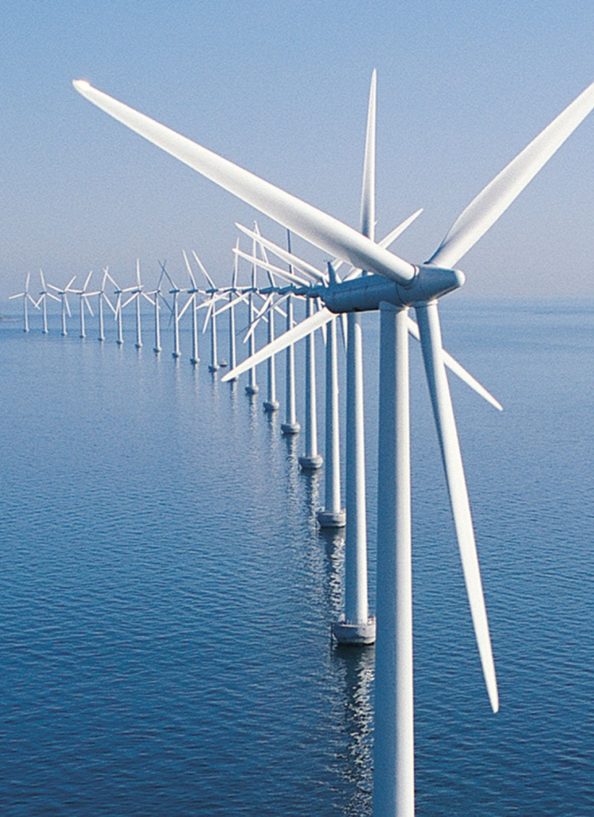
Offshore Wind Overview
Huge Resource, Close to Load
Higher Cost
Massachusetts-Made Energy
Local Job Creation
Climate Change
Regional Generation Retirements

Slide 4
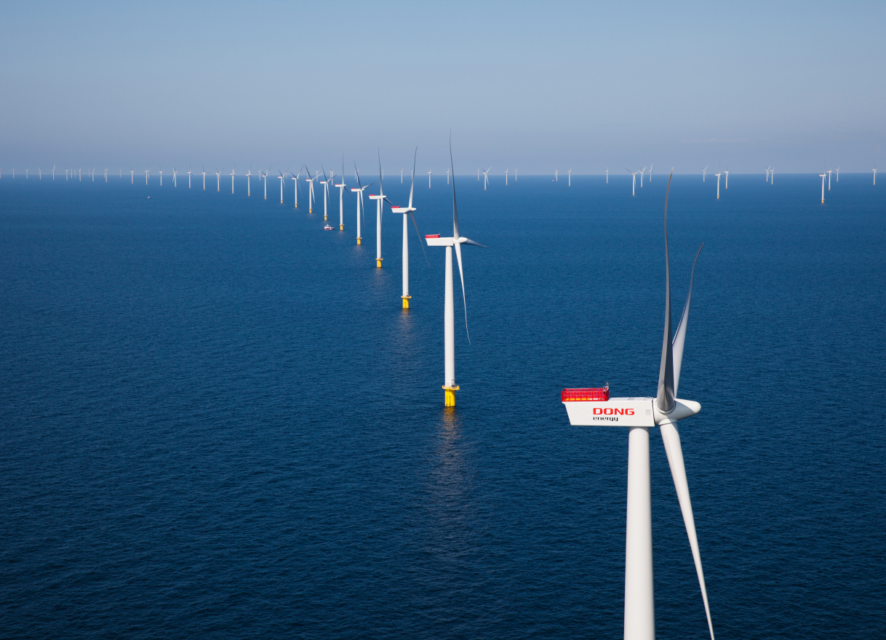
Offshore Wind in Europe
AS OF END OF 2014
2,488 turbines in 74 wind farms
8,045 MW
58,000 jobs (2013)
1% of EU’s electricity consumption
IN 2015/2016
12 offshore projects totaling 3 GW are currently under construction
IN THE FUTURE
26.4 GW of consented offshore wind projects in Europe
Anholt Offshore Wind Farm, Denmark
111 wind turbines, 400 MW

Slide 5
Offshore Wind in the United States

Slide 6
Offshore Wind Initiatives
Planning for potential Offshore Wind development in the Commonwealth:
Stakeholder Engagement
Marine Wildlife Surveys
Transmission Study
Marine Commerce Terminal

Slide 7
OSW Stakeholder Engagement
Since 2009, MA - BOEM Task Force with Feds, Tribes, State, Local
Convened over 100 public & stakeholder meetings
Formed Fisheries & Habitat Working Groups
Reduced OSW Area by 60%

Slide 8
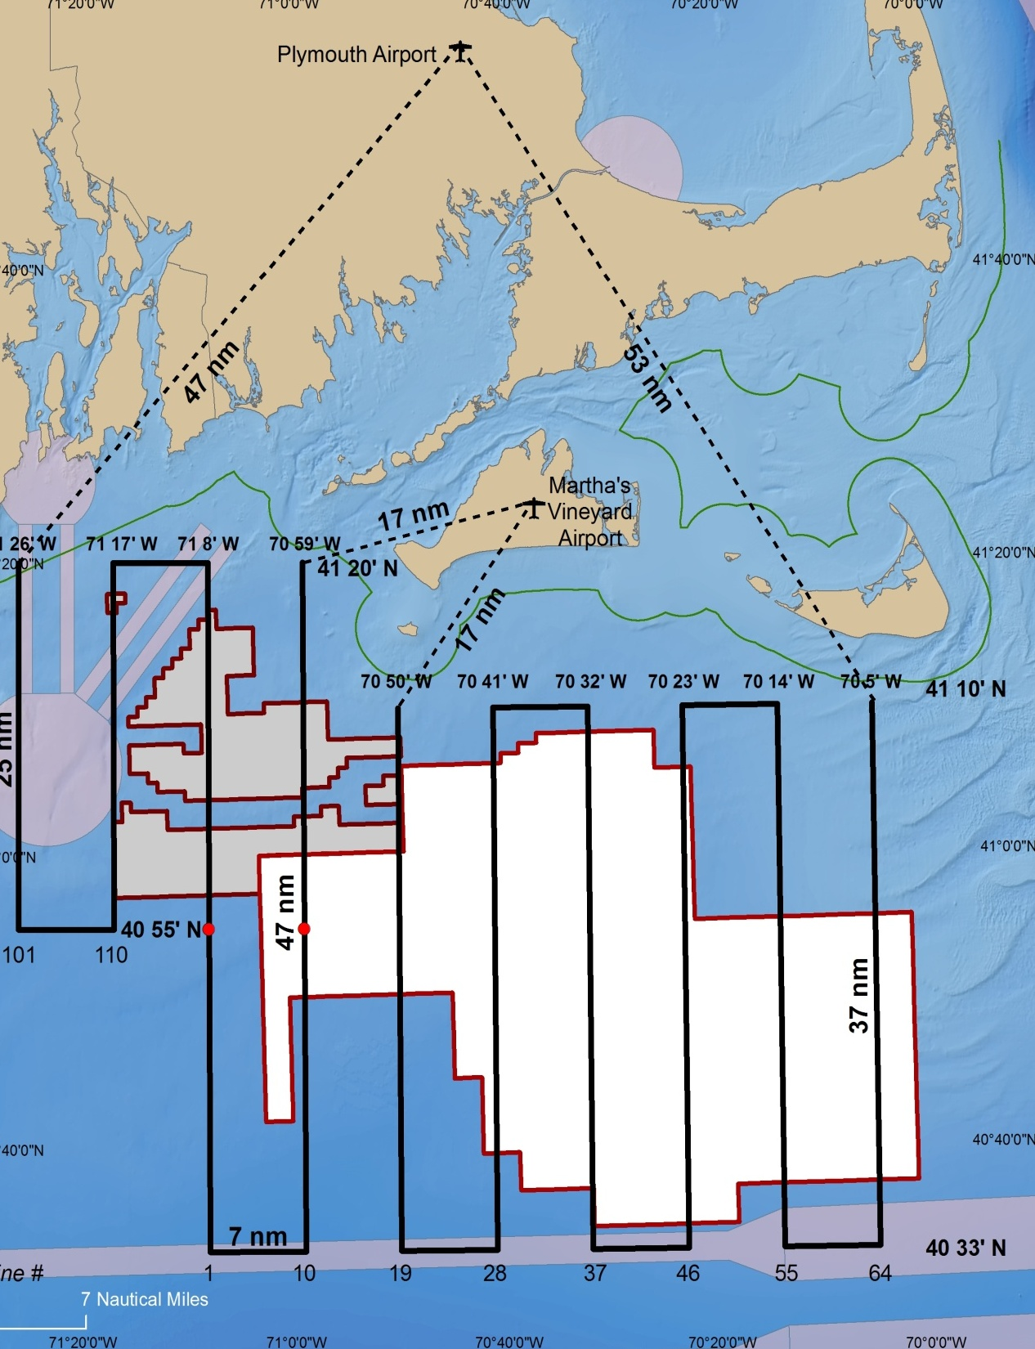
OSW Marine Wildlife Survey
MassCEC co-funded a three-year effort in partnership with BOEM:
Large Whales and Turtles
New England Aquarium
Aerial Surveys
Underwater Acoustical Buoys
Avian
College of Staten Island
Aerial Surveys

Slide 9
OSW Transmission
Potential Interconnection Locations

Slide 10
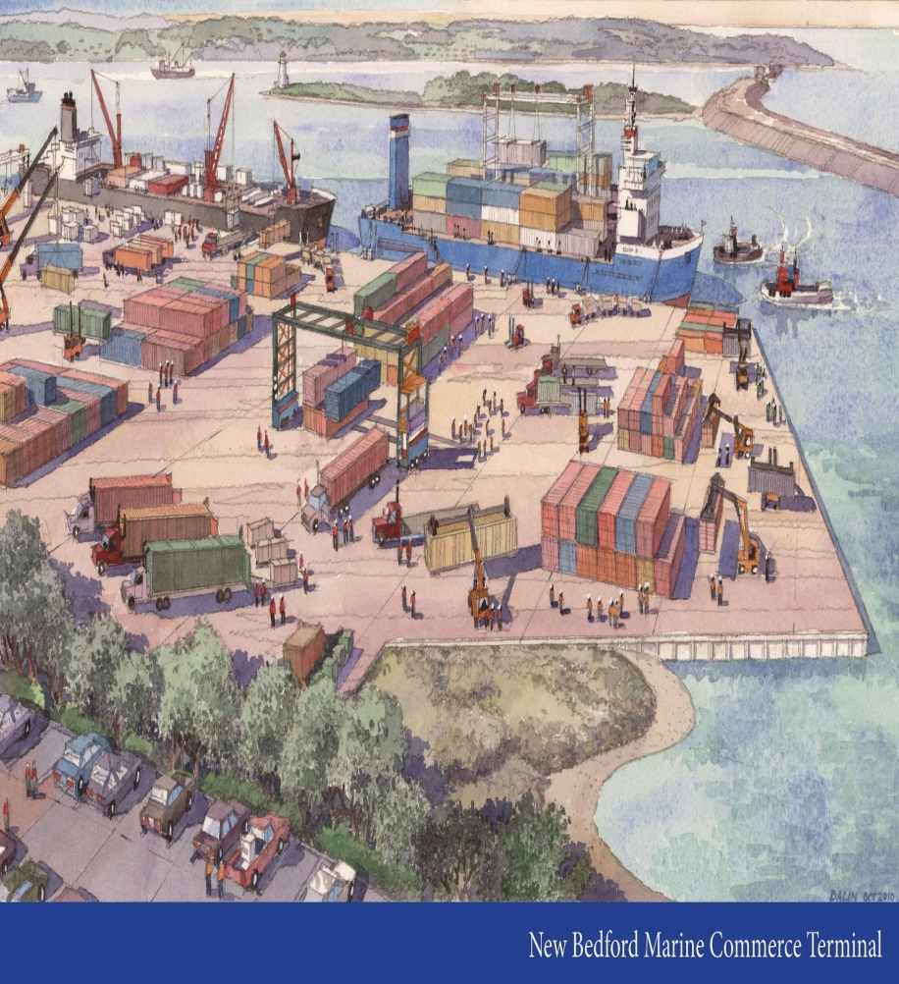
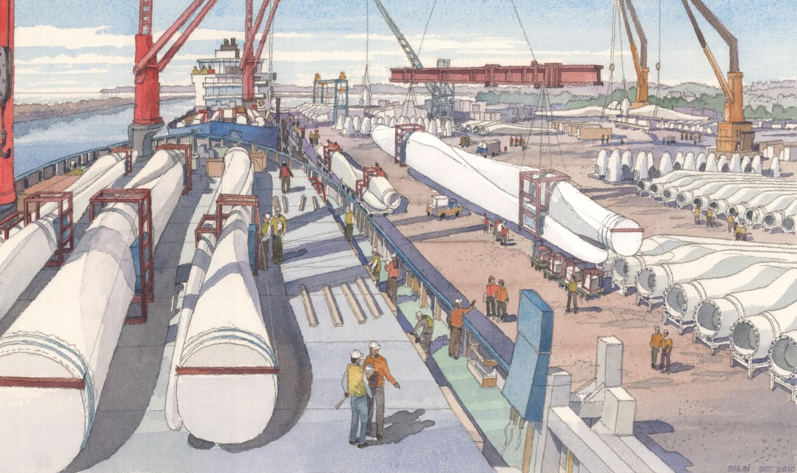
Marine Commerce Terminal
The Terminal is a multi-purpose facility designed to support the construction, assembly and deployment of offshore wind projects, as well as handle high-volume bulk and container shipping, industrial equipment and large specialty marine cargo
Marine Commerce Terminal in New Bedford, MA

Slide 11
New England OSW Lease Areas

Slide 12
Offshore Wind Leases
BOEM issues leases for renewable energy development on the Outer Continental Shelf
BOEM’s renewable energy program has 4 phases:
Planning
Leasing
Site Assessment
Construction and Operations
Once a developer wins a lease, it has 1 year to submit a Site Assessment Plan to BOEM, and 5 years to begin construction. Term is 25 years.

Slide 13
BOEM Auctions in New England
July, 2013 Auction
Deepwater Wind: Rhode Island based developer backed by D.E. Shaw. Won 165,000-acres for $3,800,000.
January, 2015 Auction
RES Offshore: Established UK-based developer with portfolio of 8-9 GW. Won 187,500 acres for $281,250.
OffshoreMW: Experienced German based developer backed by Blackstone. Meerwind, 288 MW project in North Sea. Won 167,000 acres for $167,000.

Slide 14
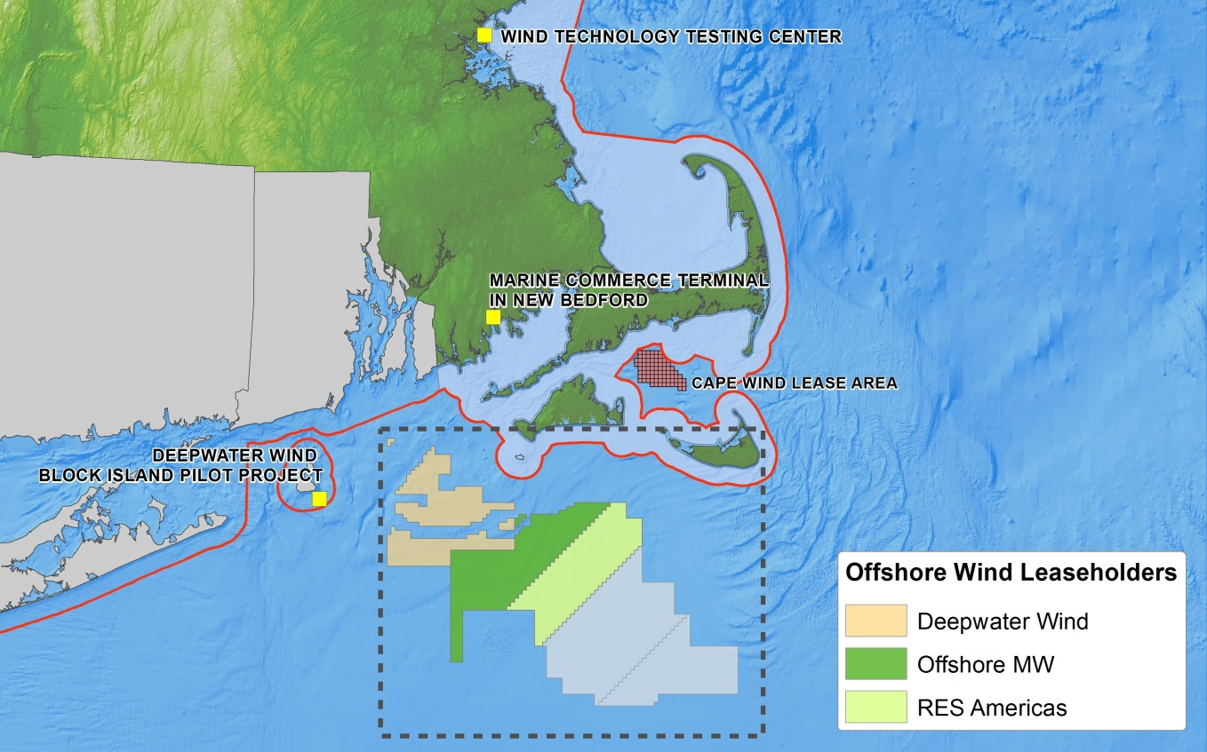
New England Offshore Wind Leases
Deepwater Wind
RES Offshore
Offshore MW

Slide 15
America’s 1st Offshore Wind Project Deepwater Wind’s Block Island
30 MW project in Rhode Island state waters
Reached Financial Close in March, 2015
Alstom 6 Megawatt Turbine
Construction Underway
Operational in 2016

Slide 16
The Cost of Offshore Wind

Slide 17
Projected Price of Electricity by Source
Less than 8
6.71
8.66
9.03
10.01
10.84
14.43
22.15
Source: U.S. Energy Information Administration, Boston Globe Staff, September 2013

Slide 18
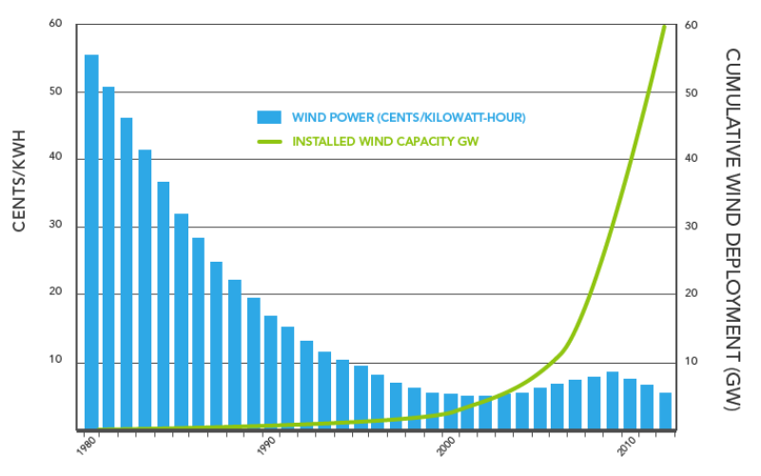
Decrease in Cost of Onshore Wind
Source: DOE Wind Technologies Market Report 2012 as presented by American Wind Energy Association

Slide 19
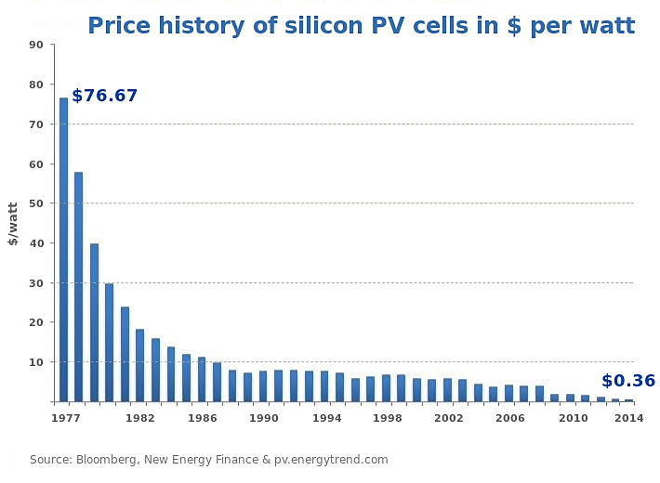
Decrease in Cost of Solar
Source: Bloomberg, New Energy Finance, pv.energytrend.com

Slide 20
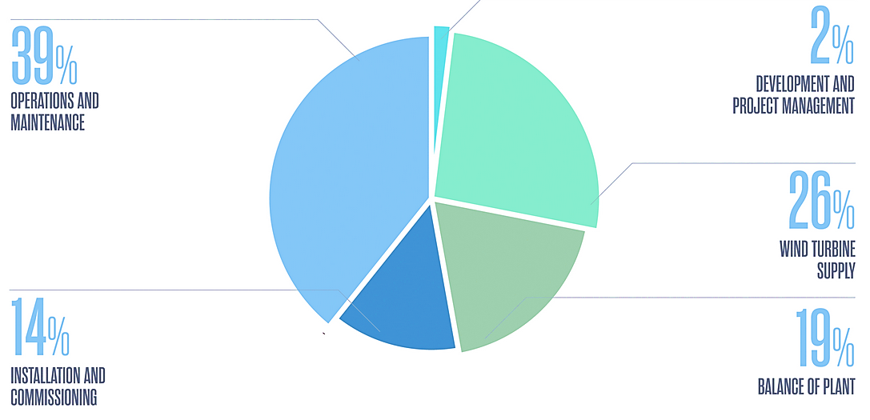
2020 UK Goal: €100/MWh
Source: Crown Estate Offshore Wind Cost Reduction Pathways Study

Slide 21
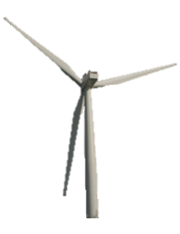
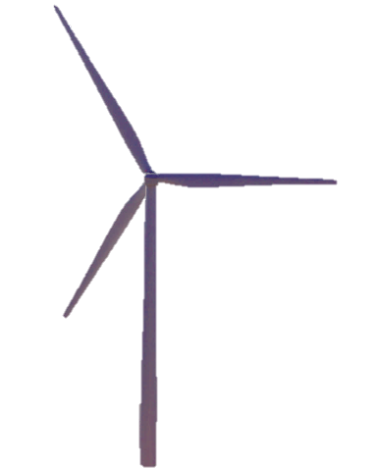
Advancement of Technology Evolution of Offshore Wind Turbines
 | GE 1.6 MW | Siemens 3.6 MW | Alstom 6 MW
Project | Cape Wind’s Original Design | Cape Wind’s Current Design | Deepwater Wind’s Block Island Design
Hub Height | 80 meters | 80 meters | 100 meters
Rotor Diameter | 82.5 meters | 107 meters | 150 meters

