Slide 1
The Impacts of Major New Environmental Regulations on New England's Electricity Future
October 29, 2010
119th New England Electricity Restructuring Roundtable

Slide 2
Industry Challenges
Continue environmental improvements
Minimize economic impacts to consumers
Maintain system reliability
Maintain fuel diversity options
Obtain access to capital and cost recovery
Long term planning in extremely uncertain and rapidly changing environmental regulatory arena

Slide 3
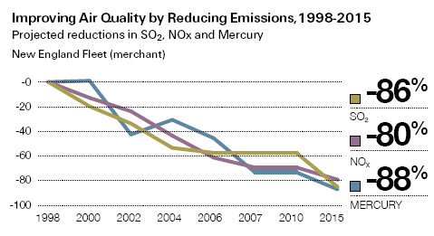
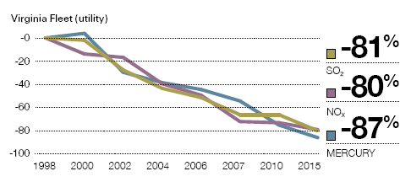
Dominion Emissions Reductions Resulting from Approximately $3.7B of Investments in Environmental Improvements
*
* 2005: Dominion acquisition of
NE fossil assets

Slide 4
Minimizing Economic Impacts to Consumers
Long investment horizons (20-30 years) require some ‘educated predictions’ of expected future legislative, regulatory and policy actions
Proper planning means that energy providers cannot – and do not – plan one rule at a time; we need to take a comprehensive approach
The highly uncertain, rapidly evolving environmental regulatory environment makes the very difficult

Slide 5
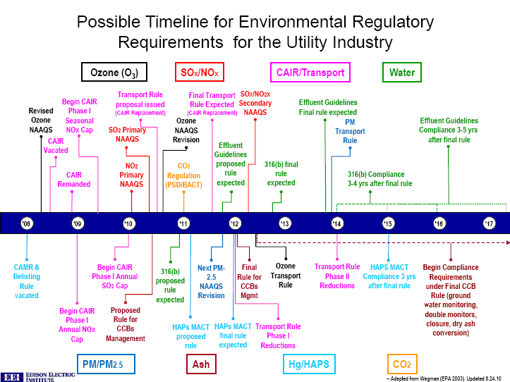
-- adapted from Wegman (EPA 2003) Updated 2.15.10
Notes:
5

Slide 6
Air Regulations
Clean Air Transport Rule (CATR) Proposal
Final Rule: Expected Spring 2011
CAIR replacement rule, called “Transport Rule”
NOx emission reductions by January 1, 2012, ozone-season NOx reductions by May 1, 2012
SO2 emission reductions, Phase I by January 1, 2012 and Phase II by January 1, 2014
New NO2 Ambient Standard
Final Rule: January 25, 2010
Compliance Date: 2017
New short-term, 1-hour National Ambient Air Quality Standard (NAAQS) for NO2 at 100 ppb
Initially only 1 non-attainment area in Cook County, IL, using data through 2008. Additional monitoring to be done near roadways and expect additional designations in 2016-2017 timeframe.
New Ambient SO2 Standard
New short-term, 1-hour National Ambient Air Quality Standard (NAAQS) for SO2 at 75 ppb.
Final rule: June 2, 2010
Compliance Date: 2014-2017
Potential additional requirements for SO2.
Currently only Merrimack, NH county only non-attainment using 2007-2009 data. Even though MA, CT and RI will have monitored attainment, they will be “unclassified” until the state can demonstrate attainment through modeling of large sources.

Slide 7
Air Regulations (con’t)
New Utility MACT Rule
Final Rule: November 2011
Compliance Date: November 2014-November 2015
MACT is maximum control achieved in practice by top 12% of like units in a source category.
Ozone NAAQS
Proposed Rule: January 2010
Final Rule: October 2010 (may be delayed)
Compliance Date: 2014-2015
EPA is proposing to strengthen the primary NAAQS for ozone to a level between 60 and 70 ppb from the current 75 ppb.
Majority of New England will be in non-attainment no matter where they set it.

Slide 8
Greenhouse Gas Tailoring Rule
Final Rule: May 2010
Compliance Date:
January 2, 2011: New sources and modified sources that must already obtain permits for non-GHG pollutants (such as SO2, NOx, and PM) will be required to obtain GHG permits and implement Best Available Control Technology (BACT) if they increase their GHG emissions by at least 75,000 tons of carbon dioxide equivalent (CO2e)per year.
July 1, 2011: The GHG permitting and BACT requirements expand to affect new sources that have the potential to emit at least 100,000 tons per year (tpy) CO2e and to existing sources with GHG emissions by at least 75,000 tpy (regardless of whether or not they trigger permitting requirements for other pollutants).
Sources that emit at least 100,000 tons of GHGs per year will also be required to account for GHG emissions in their Title V operating permits starting July 2011.
Still awaiting EPA GHG BACT Guidance document.
Concern about permitting delays while regulators and companies negotiate BACT for GHGs – no experience.
Very important that biomass be considered carbon neutral to encourage new, renewable energy.

Slide 9
New Federal Ash Rules
EPA is proposing to regulate ash, either as a hazardous or non-hazardous waste.
Final Rule: 2011
We believe that EPA should go with the Subtitle D “Prime” option which will establish an environmentally protective program for CCB disposal units without adversely affecting coal ash beneficial use and imposing unnecessary regulatory costs on power plants, threatening jobs and increasing electricity costs.
existing impoundments could continue to operate for remainder of useful life;
would not require closure or installation of composite liners in existing surface impoundments that meet groundwater and dam integrity standards and perform in an environmentally sound manner; and
all other “D” requirements would remain the same.

Slide 10
New Cooling Water Intake Structure Rules
Final Rule: 2012
Compliance Date: ?
EPA is developing new rules under Clean Water Act Section 316(b) that govern existing utilities that employ a cooling water intake structure and that have flow levels exceeding a minimum threshold (125 MGD).
New rule should be consistent with the Supreme Court ruling on cost-benefit analysis.
Furthermore, cost benefit analysis should be done on a site specific basis.
Stringent 316(b) rules are contrary to EPA’s carbon/clean air agenda.
Diverts capital away from clean air projects
Reduces generation capacity of existing facilities

Slide 11
Effluent Guidelines
Proposed Rule: 2011-2012
Final Rule: 2013
Compliance Date: 2016-2018
More stringent limitations and/or requirements for new treatment technologies at most generation facilities for discharges from ash ponds, metal ponds, coal pile runoff, boiler blowdown, etc.

Slide 12
National GHG Legislation
A year ago, we anticipated Congress would pass GHG legislation
Dominion supported national cap-and-trade legislation with reasonable targets and timetables
New Congress not expected to pass carbon legislation in near term
As a result, regional programs are continuing and EPA moving toward regulation under Clean Air Act which was not designed with GHGs in mind.

Slide 13
Tackling the Maze of Environmental Requirements
Maintain electric system reliability
Large capital investments
Electric companies need regulatory certainty
Need air regulation compliance dates to synchronize
Would like a reasonable transition for the electric generating fleet for units that will be shutdown, converted, repowered or fully controlled.

Slide 14
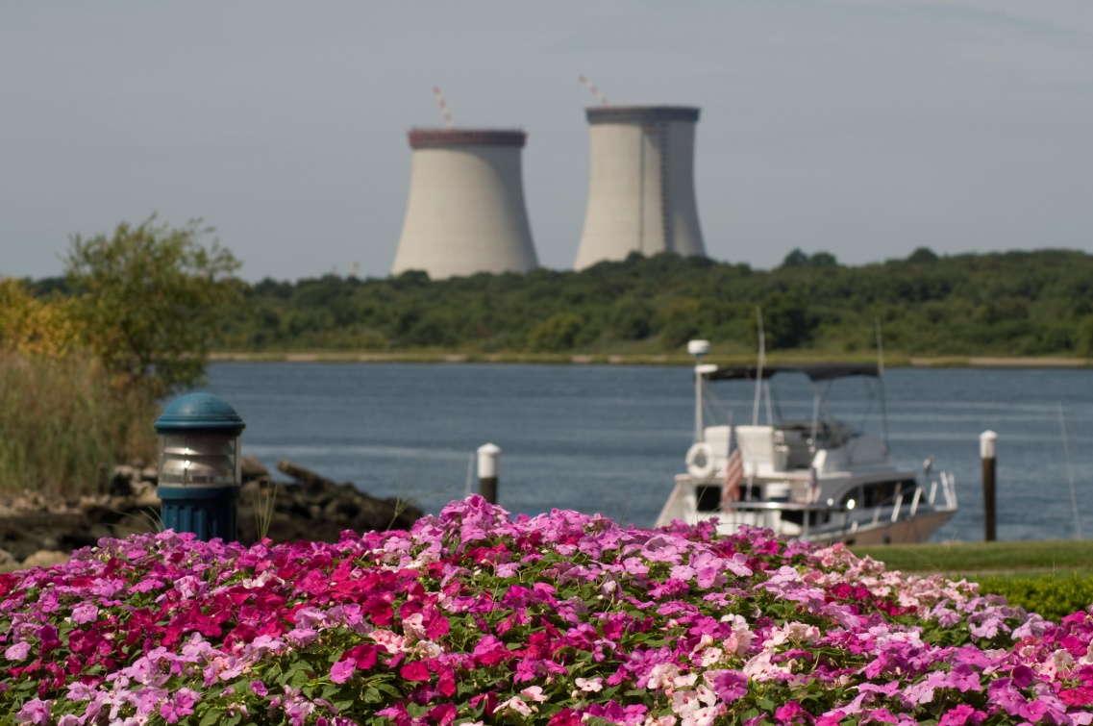
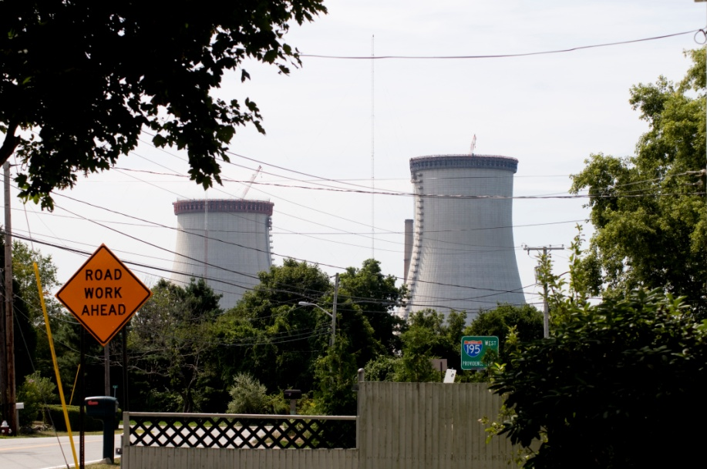
Brayton Point Cooling Towers
Located in Somerset/Fall River, MA

Slide 15
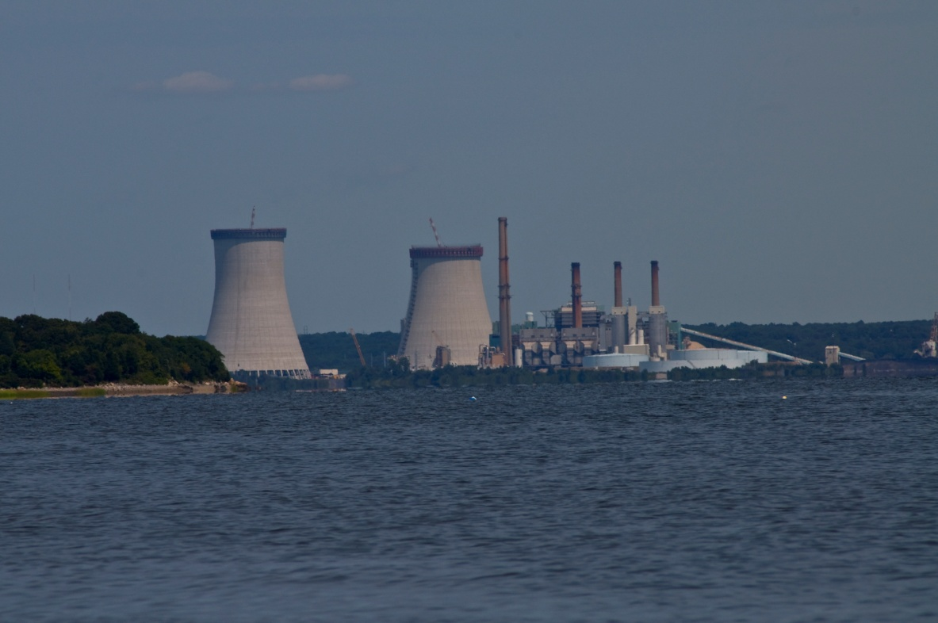
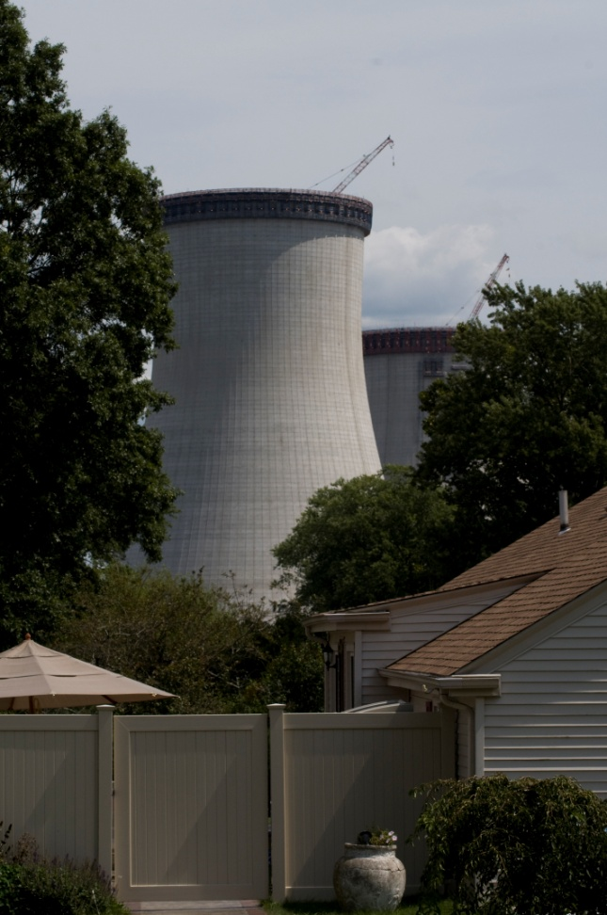
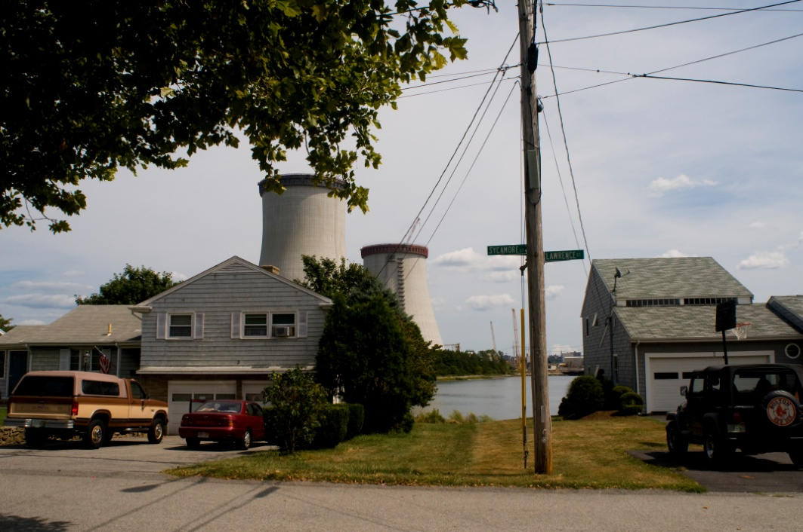
Brayton Point Cooling Towers
Located in Somerset/Fall River, MA

Slide 16
Points of Contact
Pamela Faggert
VP and Chief Environmental Officer
(804) 273-3467 pamela.faggert@dom.com
Daniel A. Weekley
Managing Director-Northeast
(860) 444-5271 daniel.a.weekley@dom.com

