Slide 1
Designing and Facilitating/Mediating Effective Stakeholder Processes
Dr. Jonathan Raab, Raab Associates
Harvard Law School
March 22, 2016

Slide 2
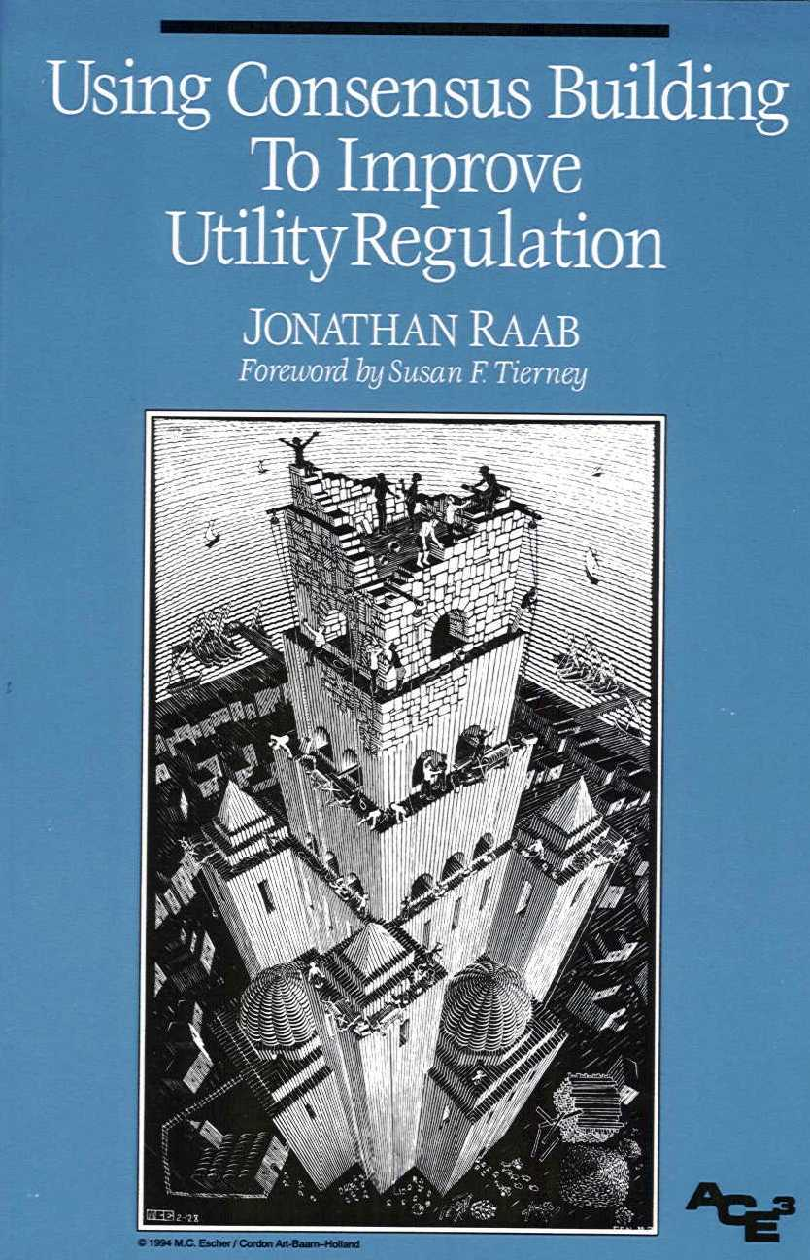

Slide 3
Consensus Building: Why Bother?
May save process related time and money
More importantly
  Can improve the practicality of policies, programs, and laws
  While enhancing their legitimacy

Slide 4
8 Principles for Consensus Building (in Electric Utility Regulation)-- From Raab (ACEEE Book)
Initiate consensus-building as early as possible.
Include all stakeholders.
Secure direct involvement of the Regulators whenever possible.
Provide adequate resources.
Do not exclude contentious or sensitive issues from consensus-building efforts.
Consider assisted negotiation (e.g., facilitation/mediation).
Structure consensus-building processes to supplement traditional adjudicatory and rulemaking procedures.
Modify traditional procedures to better accommodate consensus-building opportunities.

Slide 5

Major Northeast Electricity-Related Matters Using ADR: (2000-2010)
RI GHG Process RI VT MA New England RGGI (9 States) | PJM Contract Disputes (Med./Arb.) RES (GHG) NTA DG LICAP/FCM
RGGI (Regional Stakeholders) Restructuring Roundtable | Cape Wind
CONSENSUS SEEKING
MEDIATION
CONSENSUS BUILDING
FACILITATION
UPSTREAM
Forming Policies & Laws
DOWNSTREAM Applying Policies & Laws

Slide 6
RGGI
(aka Regional Greenhouse Gas Initiative)

Slide 7
RGGI History
2003, NY Governor George Pataki invites Northeast and Mid-Atlantic Governors to join RGGI
Nine states join (plus MD/PA observers)
Establish regional stakeholder process as “sounding board”
2005 MOU; 2006 Model Rule
2009 RGGI kicks in (New England, NY, DE, MD, & NJ (NJ drops out in 2012))
2013 States agree to reduce cap 45%
2016 Undergoing 2nd 3 year review

Slide 8
Original RGGI Policy Development Structure
Staff Working Group—environmental and energy agencies in each state
Regional Stakeholder Group as “sounding board”
  23 Members—Energy Companies; Enviros; Business; & Consumer Advocates
  Facilitator: Raab Associates
Resource Panel
  ISOs and other experts
Extensive modeling
  IPM electricity sector model (ICF)
  REMI economic impacts model

Slide 9
Regional Stakeholders
23 members
  Environmental (8)—ENE, PIRG, CLF, PACE, NRDC, ED, UCS, ACEEE
  Energy related companies (8)—AES, Constellation, Dominion, Entergy, Keyspan, National Grid, NEGT, NU
  Business (5 )—International Paper, UTC, NE GHG Coalition, NY Coalition, NE Council
  Consumer Advocates (2)—ME, PA

Slide 10
RGGI Original Agreement
Regional Cap: Caps emissions; declines 2.5%/year after 2014; 10% reduction by 2019
Apportionment of Cap: “negotiated” among states, “largely” based on average emissions over several years
Allocation of Allowances: At least 25% to be auctioned for consumer benefit or strategic energy purposes (% up to each state)
Other Features:
  Applies to all generators > 25 MW
  Limited offsets
  Flexibility mechanisms (banking, etc.)

Slide 11
Impact on Typical Household Bills
Results for SWG Proposed Package Scenario
under High Emissions Case
Based on annual average HH electricity bills for 2004-2005 from EIA Electric Power Monthly.

Slide 12
Post-MOU RGGI Developments
Maryland Legislature passes law to join RGGI
August 15, 2006 RGGI puts out 163 page model rule
2006 Vermont Legislation requires auctioning of 100% of allowances for “consumers”, NY follows with similar requirement
January 18, 2007 Massachusetts Governor Patrick signs RGGI
February 5, 2007 Rhode Island Governor signs RGGI
MA, RI, and CT join VT and NY w/100% auction proceeds to energy efficiency

Slide 13
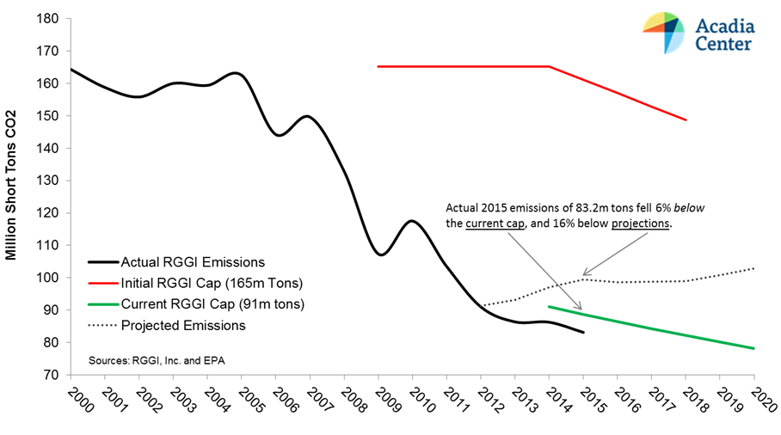
RGGI Environmental Performance

Slide 14
RGGI Allowance Auctions
(31 Quarterly Auctions 9/08 to 3/16)
State | Allowances Sold (millions) | Proceeds ($ million)
Connecticut | 53 | $160
Delaware | 27 | $88
Maine | 25 | $77
Maryland | 167 | $506
Massachusetts | 133 | $404
New Hampshire | 34 | $105
New York | 306 | $926
Rhode Island | 15 | $50
Vermont | 6 | $18
Total Participating States | 767 | $2,336
New Jersey (pre-withdrawal) | 48 | $113
Total | 816 | $2,449

Slide 15
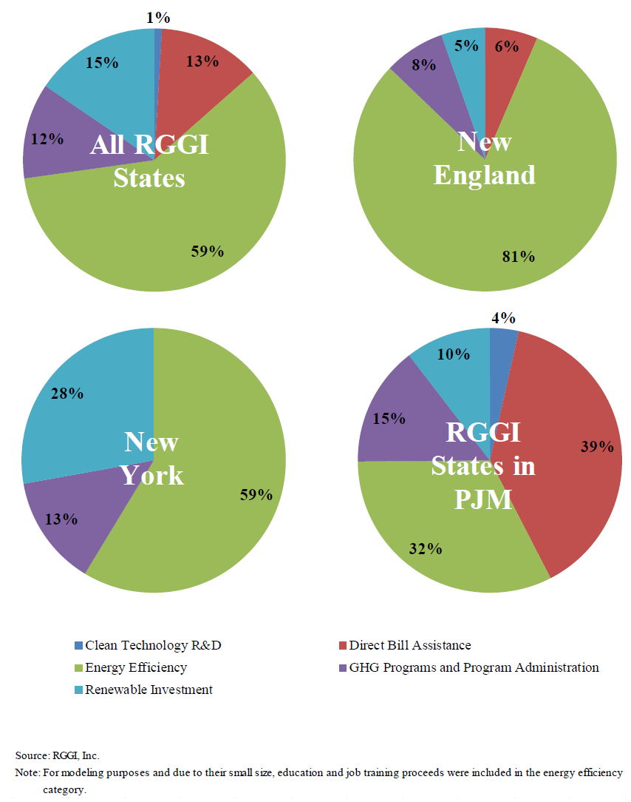
How the 9 RGGI States used the proceeds of RGGI auctions 2011--14 ($983 million):
From Analysis Group evaluation for RGGI States

Slide 16
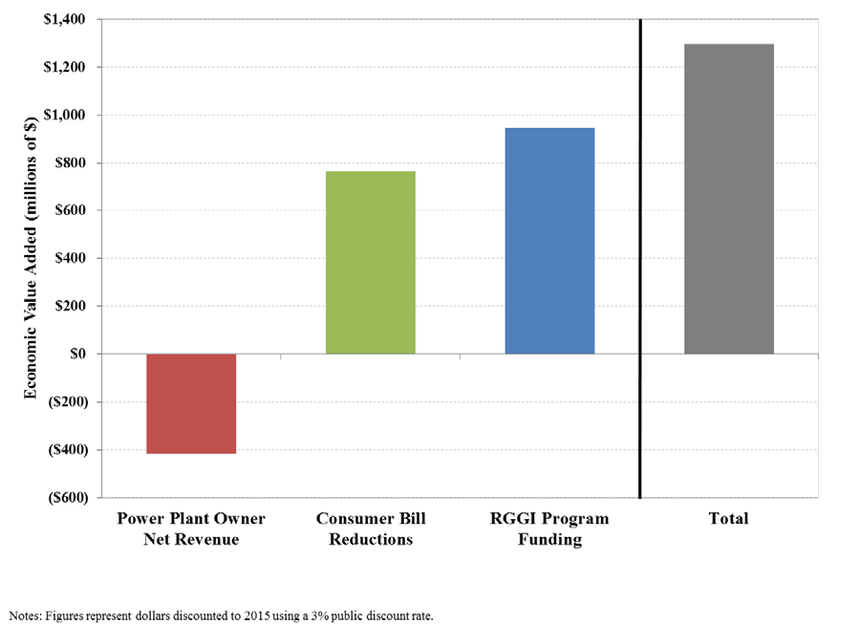
Net Economic Benefits 2012-14
(Analysis Group for RGGI States)

Slide 17
RGGI Part of Broader GHG Policy Context in Northeast
New England Governors & Eastern Canadian Premiers GHG Reduction Goal Agreements
  2001—10% by 2020 and 75-85% by 2050
  2015—35-45% by 2030
  All sectors
State GHG Reduction Plans
  Most states have comprehensive mitigation plans across all sectors for 2020
  Beginning to plan for 2030 (not just forward from 2020 but now must think back from 80% by 2050)
EPA Issues Draft Clean Power Plan Rules
  Supreme Court puts implementation on hold
  Joining RGGI likely important compliance path for other states

Slide 18
Engaging Citizens in Policy Decisionmaking
Vermont Energy Future Case Study
  Regional stakeholder workshops
  Deliberative polling
  Stakeholder group at service of citizens
Boston Climate Action Planning Process
  Neighborhood workshops, and high school student workshops
  Citizen engagement at service of stakeholder deliberations

Slide 19
PJM Regional Transmission Organization
Re-engineering a complex members organization for better collaboration
Notes:
Pat to Start

Slide 20
Key Questions
How do you improve a decisionmaking process with thousands of individuals, hundreds of organizations, over 300 meetings, per year, and billions of dollars/year at stake?
How do you sustain a shift in an organizational culture and engrained behaviors?
What is the role ADR skills and professionals in such a process?

Slide 21
Background
PJM coordinates the movement of wholesale electricity in most of 13 states and the District of Columbia to over 61 million customers.
PJM ensures the reliability of the largest centrally dispatched grid in North America. Its peak load of over 150,000 MW generated by hundreds of nuclear, coal, gas, and wind generators (plus increasing amount of solar).
PJM Interconnection is a limited liability company and regional transmission organization ("RTO"), regulated by the Federal Energy Regulatory Commission ("FERC”)
PJM's is required to act independently and impartially in managing the regional transmission system and the wholesale electricity markets

Slide 22
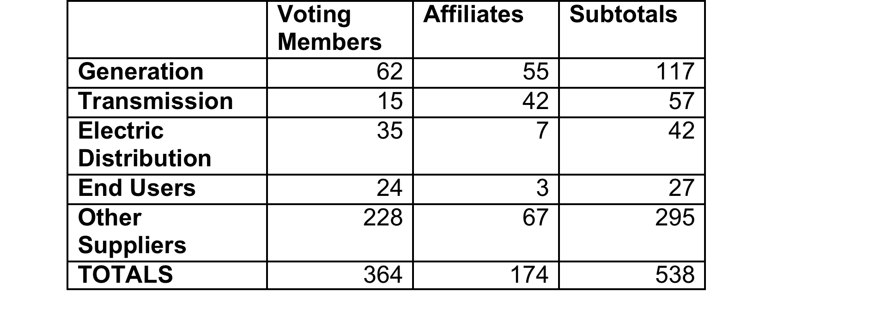
Membership as of 2009
**Currently over 500 voting members and over 800 total members

Slide 23
Context
Decisions by Members in broad terms have to do with: 1) governance; 2) reliability; and, 3) competitive markets
The PJM stakeholder process is relatively unique among U.S. RTOs in that the members’ decisions are not merely advisory to the independent operator or Board, but in many cases, are de facto binding or incumbent upon the operator

Slide 25
PJM Structure and # Meetings/Year (2009)
25

Slide 26
Unique Decisionmaking
The Members Committee is the final decisionmaking body of the members
It makes decisions through acclamation (consensus) where possible and “sector weighted voting” with a 2/3rds (supermajority) threshold otherwise
Each sector, regardless of number of members, is allocated 1/5 of the “votes”
Each vote is weighted by sector, pro and con, and tallied (affiliate companies can not vote at MC & MRC
Below MC & MRC voting by majority and affiliate companies can vote

Slide 27
Impetus for Action
PJM members grew increasingly frustrated over not reaching agreement on high priority (and generally controversial) issues
On October 17, 2008, the Federal Energy Regulatory Commission (FERC) issued Order 719 requiring PJM (and other RTOs) to undertake an examination of several aspects of their operations including their stakeholder processes
As a result of both, in March 2009, PJM member companies negotiated and approved creation of a Governance Assessment Special Team ("GAST").
The GAST was to conduct its work in two phases.
  In Phase I, the GAST was to undertake an assessment of the concerns of the broader PJM membership.
  Phase II was to include a negotiated process to recommend changes to address the concerns
GAST retained Raab Associates, Ltd. and CBI in June 2009 to perform an assessment of PJM’s stakeholder process; and later Al Roth from HBS joined us

Slide 28
Assessment: Summer 2009
The Assessment Phase
Notes:
Pat 13 & 25

Slide 29
Assessment Process
From June to September 2009
Met with GAST four times
Completed 75 confidential interviews
Observed various GAST meetings
Conducted four (4) focus groups with related entities (State regulators, PJM Board, etc.)
Conducted background research on and interviews with other Regional Transmission Operators (RTOs)and several comparable membership organizations in the U.S.
Gathered 114 company response to an on-line survey of all PJM members
Prepared findings and recommendations for PJM Members Committee (MC)

Slide 30
GAST Phase I
Governance Assessment
Strengths: Stakeholder process is beneficial for vetting issues – even if no consensus
Fairness and Other Process Issues
Efficiency Issues
Issues take extended and multiple meetings to resolve
Numerous meetings require significant resources
Stakeholder working groups processes are not structured to:
Managing PJM’s facilitation and advocacy role
Member uncertainty around PJM’s role in communicating Member views to the Board
Closely following all RTO issues is difficult for many stakeholders and especially those with limited resources
Foster problem solving
Reach consensus
Promote understanding
Phone participants often feel disadvantaged by technical/voting issues
Inconsistent application of Member’s Handbook process rules between work groups

Slide 31
Stakeholder Process Objectives

Slide 32
Stakeholder Process Goals
32

Slide 33
Key Areas of Convergence
(#s on scale is 1 to 6)
Most important goals of stakeholder process: help PJM meet it’s mission (5.7), and inform the Board of Members’ perspectives (5.3)
It is beneficial for issues to be vetted through the PJM process even when Members can’t reach agreement (5.2)
PJM and its Members need to do a better job prioritizing issues (4.2), setting deadlines (4.1), and framing issues (4.2)
Working groups should strive for consensus on a single proposal, elevating multiple proposals if no consensus (5.2)

Slide 34
Key Areas of Convergence
Satisfaction with PJM’s technical assistance role (5.0), and agreement that there facilitative role is very uneven across staff (4.7) and needs to be adjusted when PJM has a strong view on an issue
Members sector placement should be better monitored and enforced (5.8)

Slide 35
Sector Weighted Voting
30. The current method of sector weighted voting is…
 | # of Respondents | Effective | Imperfect, but Workable | Not Desirable, but Unlikely to Change | Very Undesirable & Must Be Seriously Reconsidered
All Members (with affiliates) | 105 | 27.6% | 21.0% | 22.9% | 28.6%
By Sector (without affiliates)
Transmission owners | 13 | 7.7% | 53.8% | 7.7% | 30.8%
Generation owners | 12 | 25.0% | 25.0% | 33.3% | 16.7%
End use customers | 12 | 58.3% | 25.0% | 16.7% | 0.0%
Electric distributors | 15 | 80.0% | 13.3% | 0.0% | 6.7%
Other suppliers | 28 | 17.9% | 25.0% | 46.4% | 10.7%
OPSI (state regulators) | 6 | 0.0% | 66.7% | 33.3% | 0.0%

Slide 36
Key Areas of Divergence
Sector weighted voting (i.e. power)
  80% of Electric Distributors find current voting method effective
  8% of Transmission owners find it effective
Extent of PJM Board transparency
  Large number of members want more transparency
  Board itself concerned about independence, deliberation, and undue influence
Role of affiliates and agents

Slide 37
Interface Between PJM
Advocacy and Facilitation
50. If PJM staff and management have a strong opinion about how an issue should be substantively resolved, should they…
 | # of Respondents | Keep it to Themselves | State it Clearly and Continue to Chair/Facilitate | State it Clearly But Assign Two PJM Staff (One to represent PJM and another to chair/facilitate) | State it clearly but bring in a 3rd party to chair/facilitate
All Members (with affiliates) | 104 | 1.9% | 40.4% | 37.5% | 20.2%
By Sector (without affiliates)
Transmission owners | 13 | 0.0% | 46.2% | 38.5% | 15.4%
Generation owners | 12 | 8.3% | 66.7% | 16.7% | 8.3%
End use customers | 11 | 0.0% | 0.0% | 54.5% | 45.5%
Electric distributors | 16 | 0.0% | 18.8% | 75.0% | 6.3%
Other suppliers | 27 | 3.7% | 29.6% | 40.7% | 25.9%
OPSI (state regulators) | 6 | 0.0% | 16.7% | 66.7% | 16.7%

Slide 38
Key Insights
Bottom Up: initial worry was on alleged failure of sector weighted voting, but most of work happens at nearly 400 meetings before voting occurs
Priority setting: Large groups must be deliberate about if and when to take up numerous issues in complex settings
Problem ID: Strong, joint problem identification key to working on the “right” problem
Structured Problem Solving: Decisionmaking for large groups requires clear, repeat procedures utilized consistently across groups and issues
Facilitation: Facilitation has to be a distinct activity even in complex, technical settings with a strong need for technical competence

Slide 39
Class Assignment
Group 1: Solution Development Process: (pp. 12-15, 18)
  How do you put in place a working group process that is efficient, effective, transparent, and repeatable to develop proposals on complex issues and reach as much agreement as possible?
Group 2: Facilitation: (pp.26-30)
  How should the meeting facilitation (mediation) role at PJM be handled such that it is both more effective and more non-partisan (recognizing that PJM currently facilitates and has both substantial expertise but also often strong opinions)?
Group 3: Decisionmaking Process: (pp. 19-25)
  What improvements would you recommend to the voting process in PJM (majority rules at Standing Committees with affiliates; sector-weighted voting at MRC & MC w/o affiliates)?

Slide 40
FACILITATION: October to August 2010
Governance Assessment Team Phase IIA
Notes:
Pat 25 to 30
Dave 30 -36
Pat 37-40

Slide 41
Process Steps
Summer 09: Phase I Consultant Assessment
Sept 09: MC Approves Phase IIA
Oct. 09 – Aug 10: Phase IIA
Interviews, poll, meeting observations, document review
Initial meetings to determine scope and process design for
MC splits Phase IIA and Phase IIB issues, with subsequent MC vote required in order to proceed with IIB
MC approves manual 8/12/10, implementation has begun
Sept 10 – June 11: Phase IIB
Research in structure, decisionmaking & voting elsewhere
July 11 – June 2012: Phase IIB Implementation
Negotiations and mediation to address final issues
Revision of manual & manual training
Coaching, training, monthly seminars

Slide 42
Phase IIA Process
Facilitation team moved from “assessors” to “facilitators”
Further scoped issues with GAST
Held monthly or more frequent meetings to proceed through issues
Used Webex, white boards, conference call in, and tried SharePoint to post documents
Created work groups for specific topics
Conducted research on other organizations and RTOs, and on alternative voting schemas
Final product was fully revised Stakeholders Manual (i.e. operating procedures) delineating a new consensus-based issue resolution (CBIR) process

Slide 43
Issues Addressed in Phase IIA
GAST Phase IIA
Sector Placement, Monitoring & Enforcement
Transparency among Board & Members
Roles & Responsibilities
Lower Level Standing Committee Process
Work Group Process
Annual Work Planning
Charter Work Groups
Other Issues
Notes:
Idea is to use this graphic to locate each topic visually as the presenter goes through the topics.

Slide 44
Group 1:
Solution Development Process
What do you recommend?

Slide 45
PJM GAST Process Overview
Work Group and Lower Level Standing Comm. Process
Problem Solving
Proposal Development
Decision Making
Problem Definition
Member Education
Interest Identification and Exploration
Numerous tools to:
Do pre-proposal development
Use group or PJM options to develop proposals
Narrow differences/options
Seeking consensus
Dealing with multiple proposals
Reporting
What proposals will be forwarded and how
Meeting summaries and agendas
Joint Fact Finding
Standardized reporting templates and processes

Slide 46
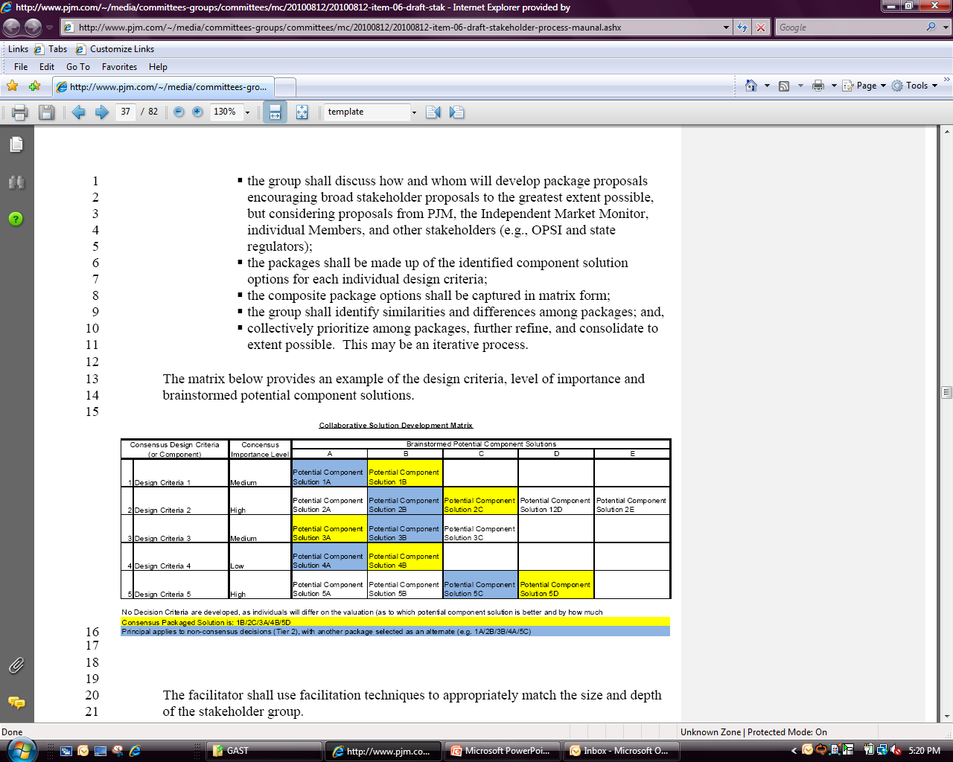
Consensus Based Issue Resolution - Process
1
2
3
4
Problem
Investigation
Proposal
Development
Decision
Making
Reporting to Parent Committees
EXAMPLE Proposal Development

Slide 47
Options Matrix (row-by-row)
Design Components | Priority | A | B | C | D
Flour | Medium | White | Whole Wheat | Gluten-Free | Rye
Sweetener | Medium | White Sugar | Brown Sugar | Honey
Shape | Low | Flat | Round | Bundt
Flavor | High | Vanilla | Chocolate | Strawberry | Almond
Moistener | Low-Medium | Oil | Butter | Sour Cream

Slide 48
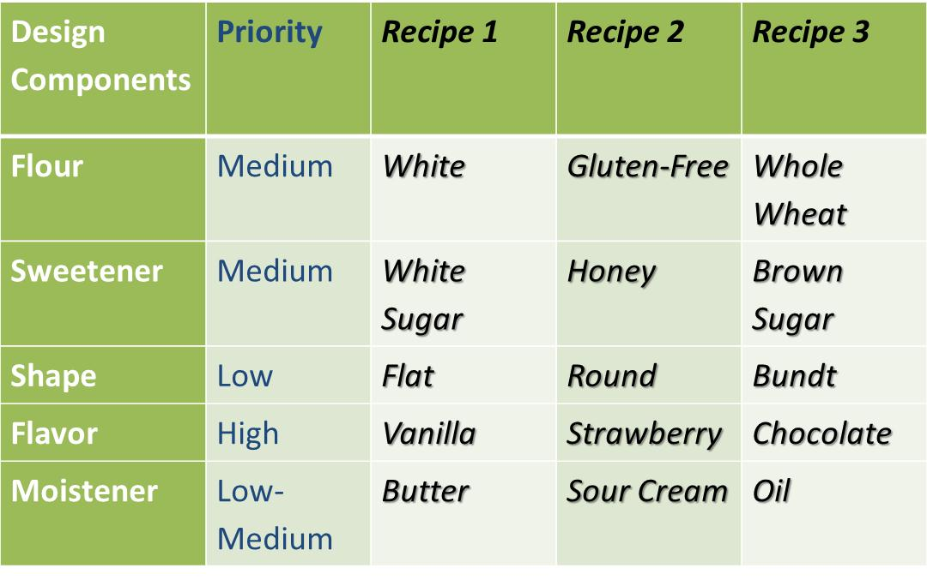
Initial Proposal (recipe) Matrix
(column-by-column)

Slide 49
Group 2:
Facilitation:
What do you recommend?

Slide 50
Facilitation Changes
Facilitation
Separate PJM facilitation and advocacy staff
Increase PJM facilitation capacity
Use Outside Facilitation, in special circumstances

Slide 51
Benefits of Phase IIA Implementation
Greater efficiency in finding areas of consensus
More consistency within workgroup processes
Improved work planning & control of workgroup direction
Enhanced stakeholder education on key issue topics
Better informed members through improved reporting
Greater clarity and separation of PJM’s multiple roles in stakeholder process
Clearer responsibilities for all
Greater assurances for minority positions
Improved transparency between Members and the Board
More efficient process for implementing tariff changes

Slide 52
Mediation: September to June 2011
Governance Assessment Team Phase IIA

Slide 53
Phase IIB
Phase IIB included:
  “Hardest” issues left to be addressed in this phase
  Quid pro quo agreement to go forward, without expectation of major structural changes
  Facilitation team moved from “facilitators” to “mediators” for the negotiations
  Approval of MC to move forward

Slide 54
Group #3
Decisionmaking Process
What do you recommend?

Slide 55
Phase IIB Issue Scope
Less Difficult
More Difficult
Voting procedures and their consistent application
Voting alignment between LLSC and Senior Committees
Most Difficult**
Sector weighting across sectors
Streamlining /consolidating further committees, subcommittees, and task forces
Role/structure of MRC/MC
Reassignment of 205 rights between members and PJM Board
Sector number, definitions, enforcement
Voting thresholds
Sub-weighting within certain sectors
Role of Agents

Slide 56
Structure of Phase IIB Mediation
Joint Fact Finding, Interest Identification, and Option Generation
Mediation
Refine Mediation
Joint Fact Finding, Interest Identification, and Option Generation (February—April)
Review Issues and Refine Mediation Plan (early May)
Mediation (late May-June)

Slide 57
Balance of Power Issue Resolution
Despite intensive mediation, were not able to find a rebalancing of voting and related power issues that created mutual gains
However, were able to partially meet the underlying interests thru the Enhanced Liaison Committee between Members and Board—consensus support from Members
Were also able to harness research on alternative voting schemas into strategic polling applications within CBIR process

Slide 58
Voting Approaches and Tools for Winnowing Proposals at TFs, Subcommittees and LLSCs
Voting Approaches Voting Tools | Plurality | Approval | Rank Order | Preference/ Allocative
Straw Polling (verbal) | X | X
Nominal Group Method (dots) |  |  | X | X
Keypad Polling | X | X | X
Web/Paper Surveys | X | X | X | X
Weighted Decision Matrix |  |  |  | X

Slide 59
Overall Polling Results: Dinner Choices
 | First Choice (preferred) | Acceptable Choice (can live with)
Beef
Chicken
Fish
Pork

Slide 60
PJM Specific Matrix/Polling
Packages* | Description | Voting Items included | Company that created Package | Preferred | Can live with Package
1 | No Change | 3A, 4A, 5A, 6A, 7A | PJM | 27 | 59
2 | Capability Reduction | 3A, 4A, 5A, 6C, 7A | Member | 0 | 34
3 | Seasonal 1 - 15 day outage modeling | 3B, 4E-3, 5A, 6A, 7A | PJM | 0 | 42
5 | Hybrid 1 | 3C, 4A, 5A, 6A, 7A | PJM | 0 | 34
6 | Hybrid 2 | 3D, 4A, 5A, 6A, 7A | PJM | 1 | 47
7 | Funding 1 - Marginal Loss | 3A, 4A, 5A, 6A, 7B-1, 7C | PJM | 11 | 26
8 | Funding 2 - Balancing Congestion charged/credited to Load | 3A, 4A, 5A, 6A, 7E | PJM | 3 | 21
10 | Hybrid 2 and Modified Annual outage modeling | 3D, 4B, 5A, 6A, 7A | PJM | 0 | 31
11 | Funding 3 - Hybrid Marginal Loss | 3A, 4A, 5A, 6A, 7B-2, 7C | PJM | 4 | 21
12 | Seasonal 3 | 3B, 4B, 5E-2, 6A, 7A | Member | 0 | 31
13 | Seasonal 4 | 3B, 4B, 5E-2, 6A, 7E | Member | 2 | 35
17 | Hybrid 3 | 3C, 4B, 5A, 6A, 7A | Member | 4 | 27
18 | Hybrid 4 | 3D, 4B, 5A, 6A, 7A | Member | 0 | 30
19 | Hybrid 5 | 3D, 4A, 5A, 6A, 7B-1, 7E, 7F | Member | 17 | 27
20 | Capability Reduction 2 | 3A, 4A, 5E-1, 6C, 7A | Member | 14 | 58
23 | Seasonal/Hybrid | 3B, 3D, 4E-3,5E,6A,7F |  | 18 | 30

Slide 61
Implementation: September 2010 to Present

Slide 62
Phase IV: Implementation & Training
Identifying key PJM leader sponsors and Member sponsors
Finalization of New Stakeholder Manual
  Complete procedures rewrite in detail
Phased Roll-Out of procedural changes
Creation of on-going Implementation Team (Key GAST Member leaders and PJM point person and facilitators)
  Weekly calls for 2 years to review roll-out progress, and trouble-shoot implementation issues and problems, suggest refinements
Periodic Member meetings to review process improvements and their implementation
Notes:
Dave implementation

Slide 63
Phase IV: Implementation & Training
Training
  Manual procedures (Members and PJM staff)
  Mutual gains negotiation (Members and PJM staff)
  Facilitation (PJM staff facilitators)
  Dealing with difficult conversations (PJM staff facilitators)
Monthly coaching sessions for PJM facilitation staff
  Key areas such as CBIR matrix development, polling, resolving difficult issues, facilitation ethics
  Staff bring examples and problems to obtain feedback
  “Nuts and bolts” issues addressed each session
Building a Roster
  Creating, building, and improving the facilitation talent of a core set of staff

