Slide 1
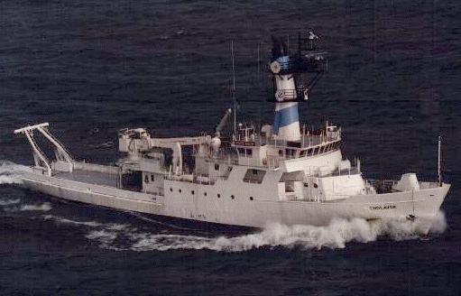
The Ocean SAMP and Offshore Renewable Energy
Jennifer McCann
URI Coastal Resources Center/Rhode Island Sea Grant
URI Graduate School of Oceanography

Slide 2
Talk Overview
1) Ocean SAMP Background
2) Current Renewable proposals
3) RI’s recent legislation
4) Questions

Slide 3
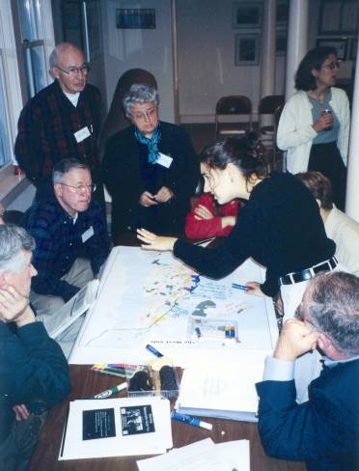
University of Rhode Island and Rhode Island Sea Grant
Internationally renowned
  oceanography, ocean engineering, coastal and ocean management
Integrating science with policy
  cutting edge scientific research
  working with communities
  local – global scales
Over 35 years of creating
Special Area Management Plans
Coastal Resources Center and
RI Sea Grant developing and implementing coastal management programs worldwide

Slide 4
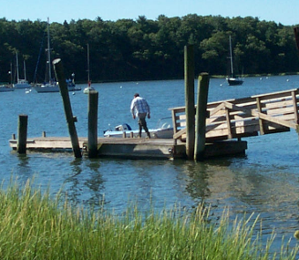
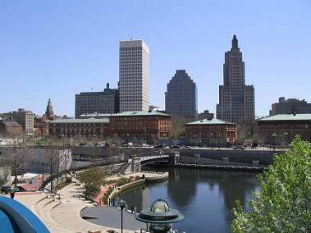
RI Coastal Resources Management Council (CRMC)
administers RI’s state coastal management program under the federal Coastal Zone Management Act of 1972 (CZMA)
management agency with state and federal regulatory functions
mandate "...to preserve, protect, develop, and where possible, restore the coastal resources of the state for this and succeeding generations….”
national leader in coastal management
Notes:
We have a coastal program that leads the nation.

Slide 5
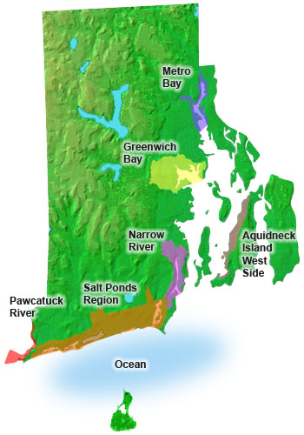
CRMC Is The National Leader In SAMP Development
The Marine Resources Development Plan:
an initiative to proactively design the coast
Special Area Management Plans are “Tools with Teeth”
Notes:
5

Slide 6
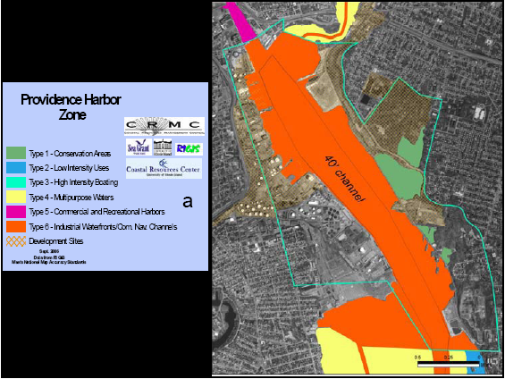
Notes:
6

Slide 7
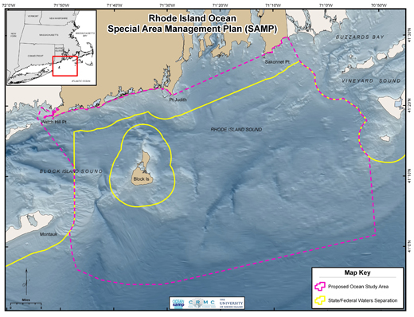



Slide 8
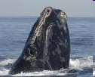
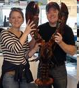
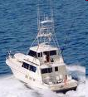


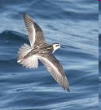





Increased demand for the use of Rhode Island’s offshore waters
Notes:
1,547-sq mi area, and includes both state and federal waters. Outer boundary is roughly 20 miles offshore and determined by transmission capabilities given current technology.
8

Slide 9
Global Climate Change Becomes
a Priority
Rhode Island sees a need to respond to the implications of global climate change by considering the investment of offshore renewable energy

Slide 10

Governor’s Mandate
  Governor Carcieri has issued a mandate that 15% of Rhode Island’s electricity come
  from wind
  RI has enough of a wind resource to deliver 70% of its current electricity needs - 95% of the resource is offshore
Notes:
10

Slide 11
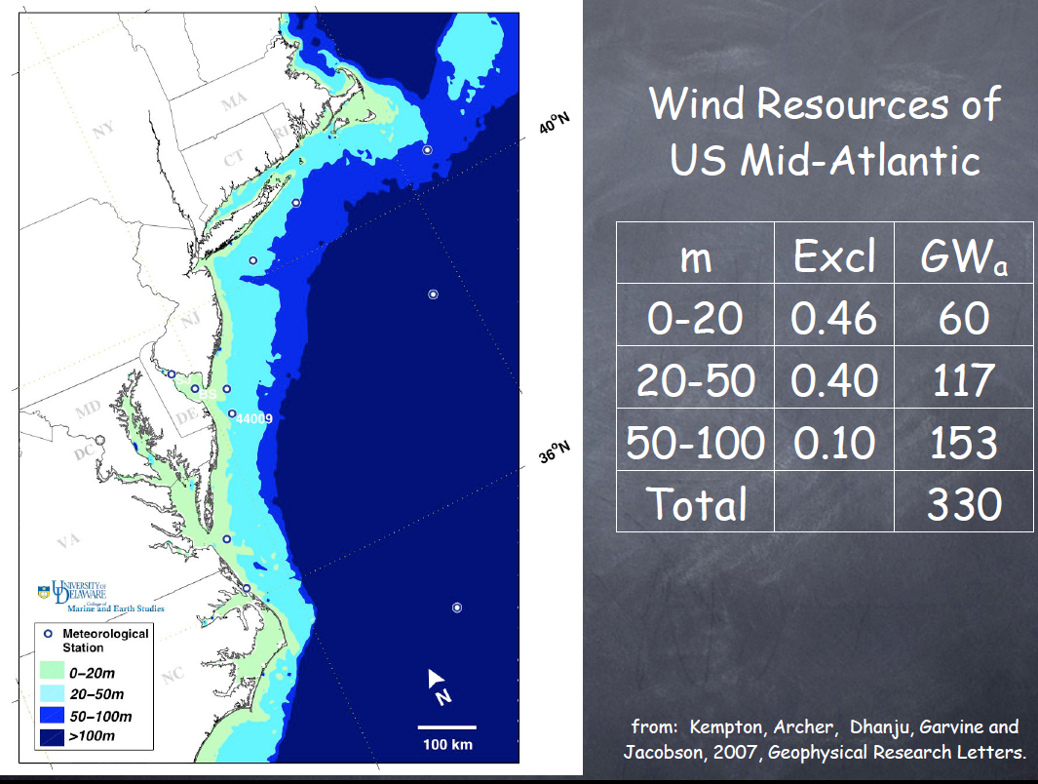
Notes:
11

Slide 12
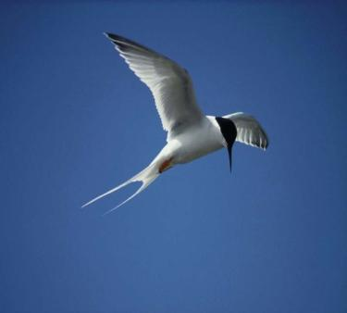

SAMP Goals
Foster a properly functioning ecosystem
Promote and enhance existing uses
Encourage marine-based economic development, including offshore renewable energy infrastructure
Build a framework for coordinated decision-making

Slide 13
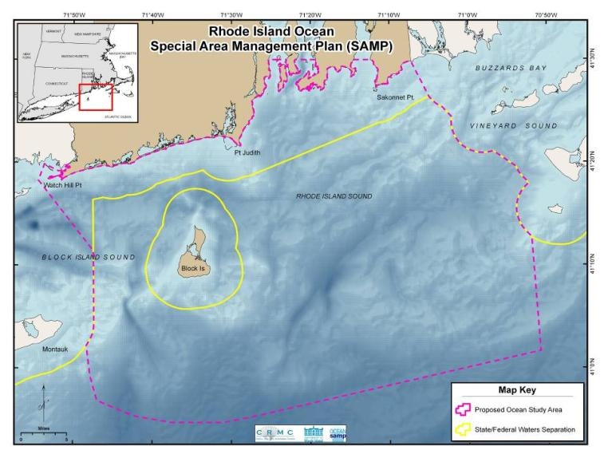
Federal Consistency
Activities affecting the coastal zone must be consistent with the enforceable policies of state coastal zone management programs that have received federal approval

Slide 14
Interstate Consistency
“Instances where a federal action occurring exclusively in one state (State "B") will have effects on the uses or resources of another state’s coastal zone (State "A")”
“the ability of State A to review the action under the Coastal Zone Management Act and NOAA's interstate consistency regulations”

Slide 15
Existing CRMC Ocean SAMP Process*
August 1, 2008 – July 31, 2010
Step 1: Issue Identification and Assessment
Step 2: SAMP Preparation
Adoption
July 2008
July 2009
July 2010
Step 1: Issue Identification/ Assessment (Aug 2008–July 2009) Define boundaries, goals and principles Design public process Research ecosystem features and uses Identify issues/concerns, opportunities Prepare draft ecosystem and use zone maps
Step 2: SAMP Preparation (Aug 2009 – April 2010) Review boundaries and goals Develop the objectives and policies for each zone and SAMP component Draft SAMP chapters Identify research gaps
Step 3: Formal Adoption (May 2010 – July 2010) Formal hearings and reviews of the draft SAMP Adoption of the SAMP by CRMC Submit to federal agencies for approval
* This timeline is based on current knowledge.

Slide 16

Ocean SAMP Document
Ecology of the Study Area
Cultural and Historical
Fisheries Resources
Recreation and Tourism
Marine Transportation
Infrastructure
Renewable Energy
Future Uses
Federal Process and Federal Consistency
Notes:
16

Slide 17
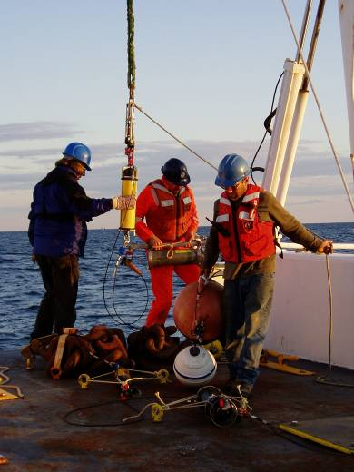
SAMP Research
Research Topics Include...
Wind resources
Marine mammals and birds
Fisheries uses
Physical oceanography
Ecosystem interactions
Sediment and benthic habitat
Cultural resources
Acoustics and electromagnetic effects
Meteorology
Engineering
Marine transportation uses

Slide 18
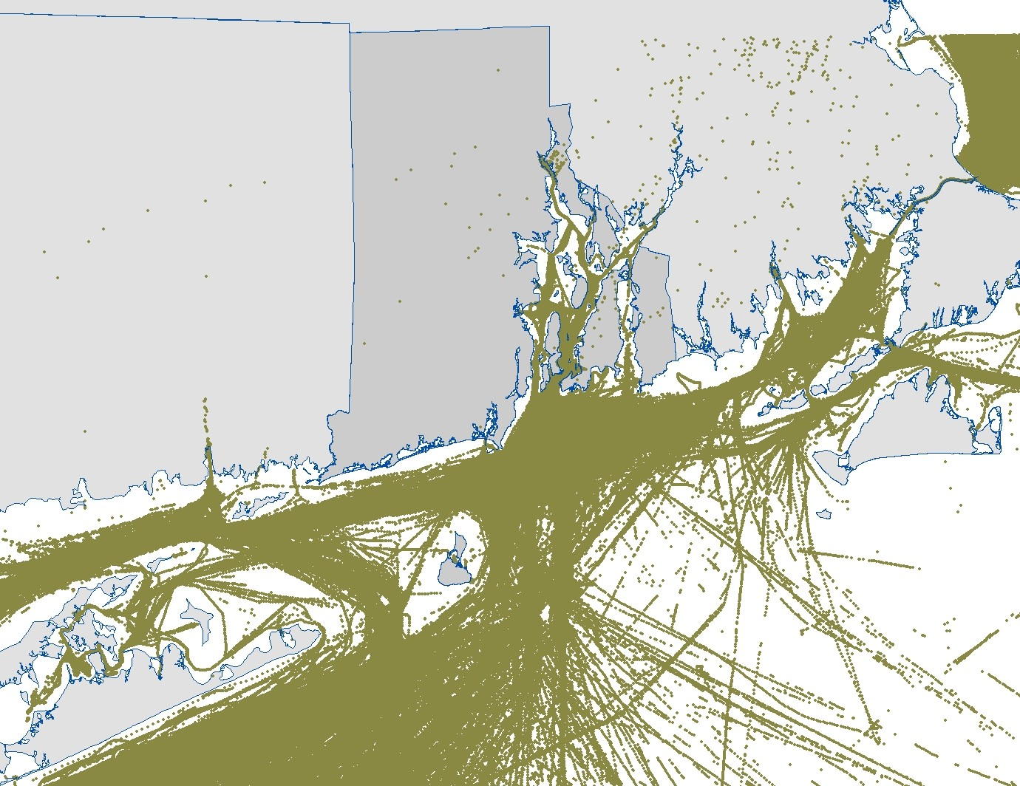
AIS Vessel Tracks
September 2007 – July 2008
Notes:
18

Slide 19
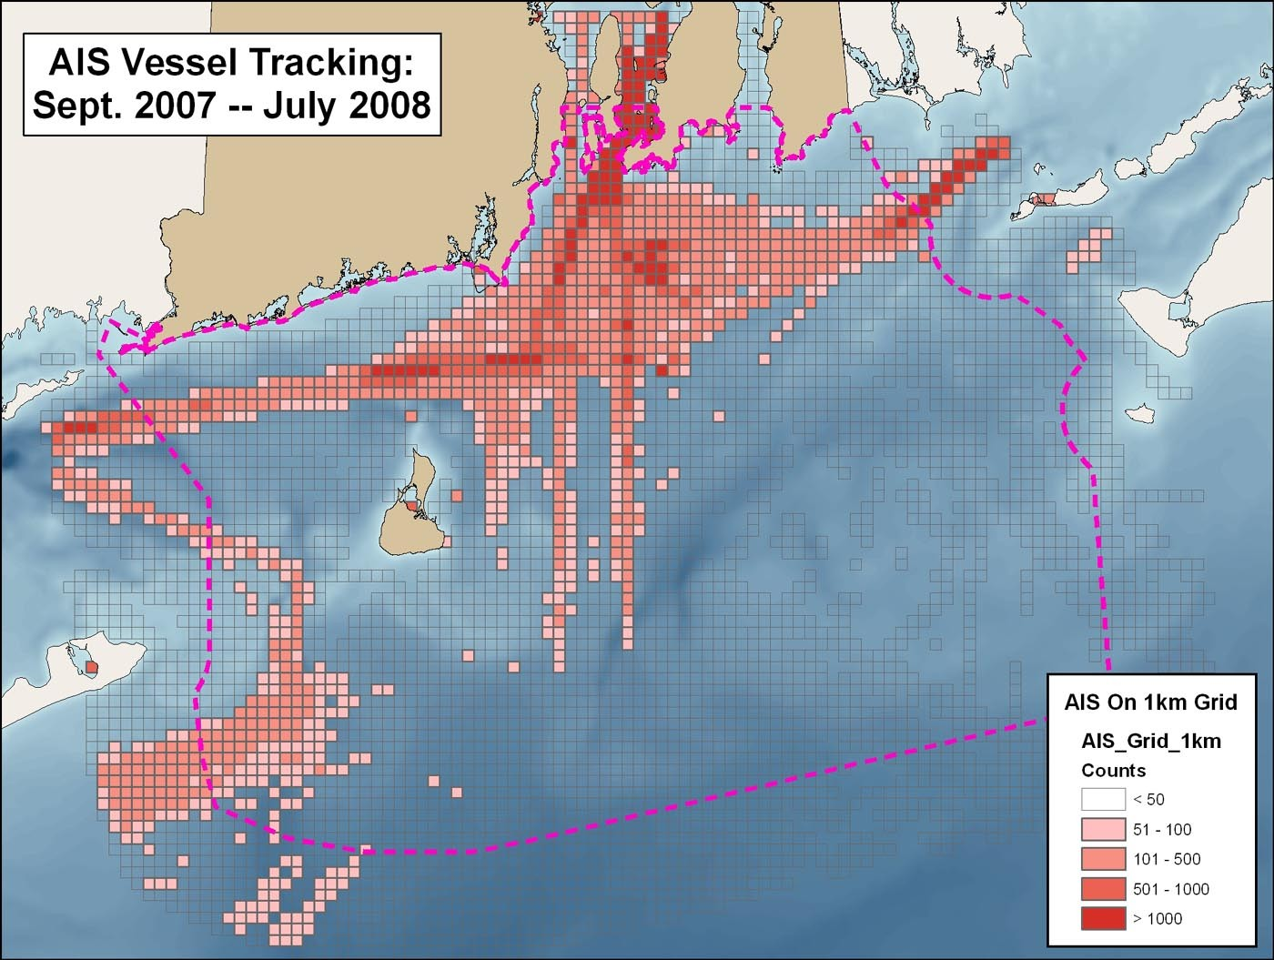
Notes:
19

Slide 20
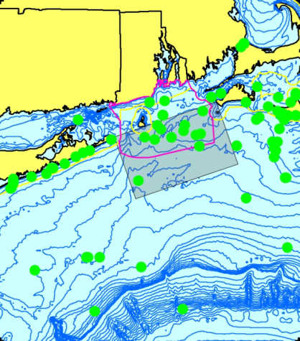
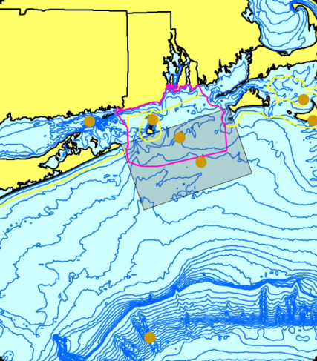
North Atlantic Right Whale,
1828-2007
Dr. Robert Kenney, URI

Slide 21
Dr. Robert Kenney, URI

Slide 22
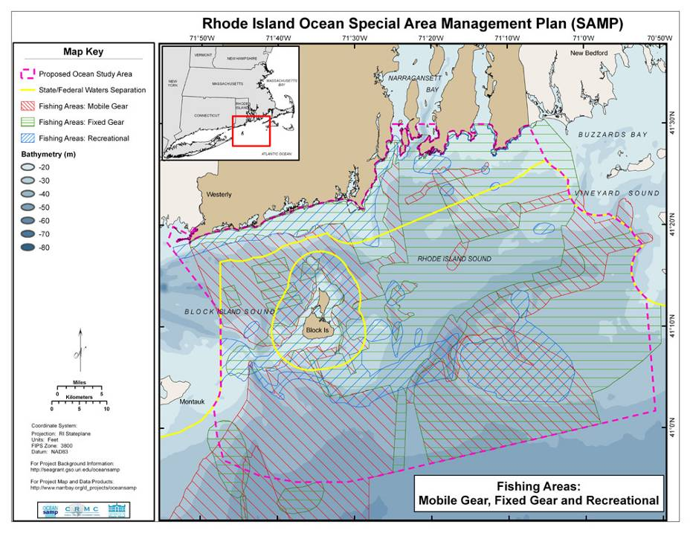

Slide 23
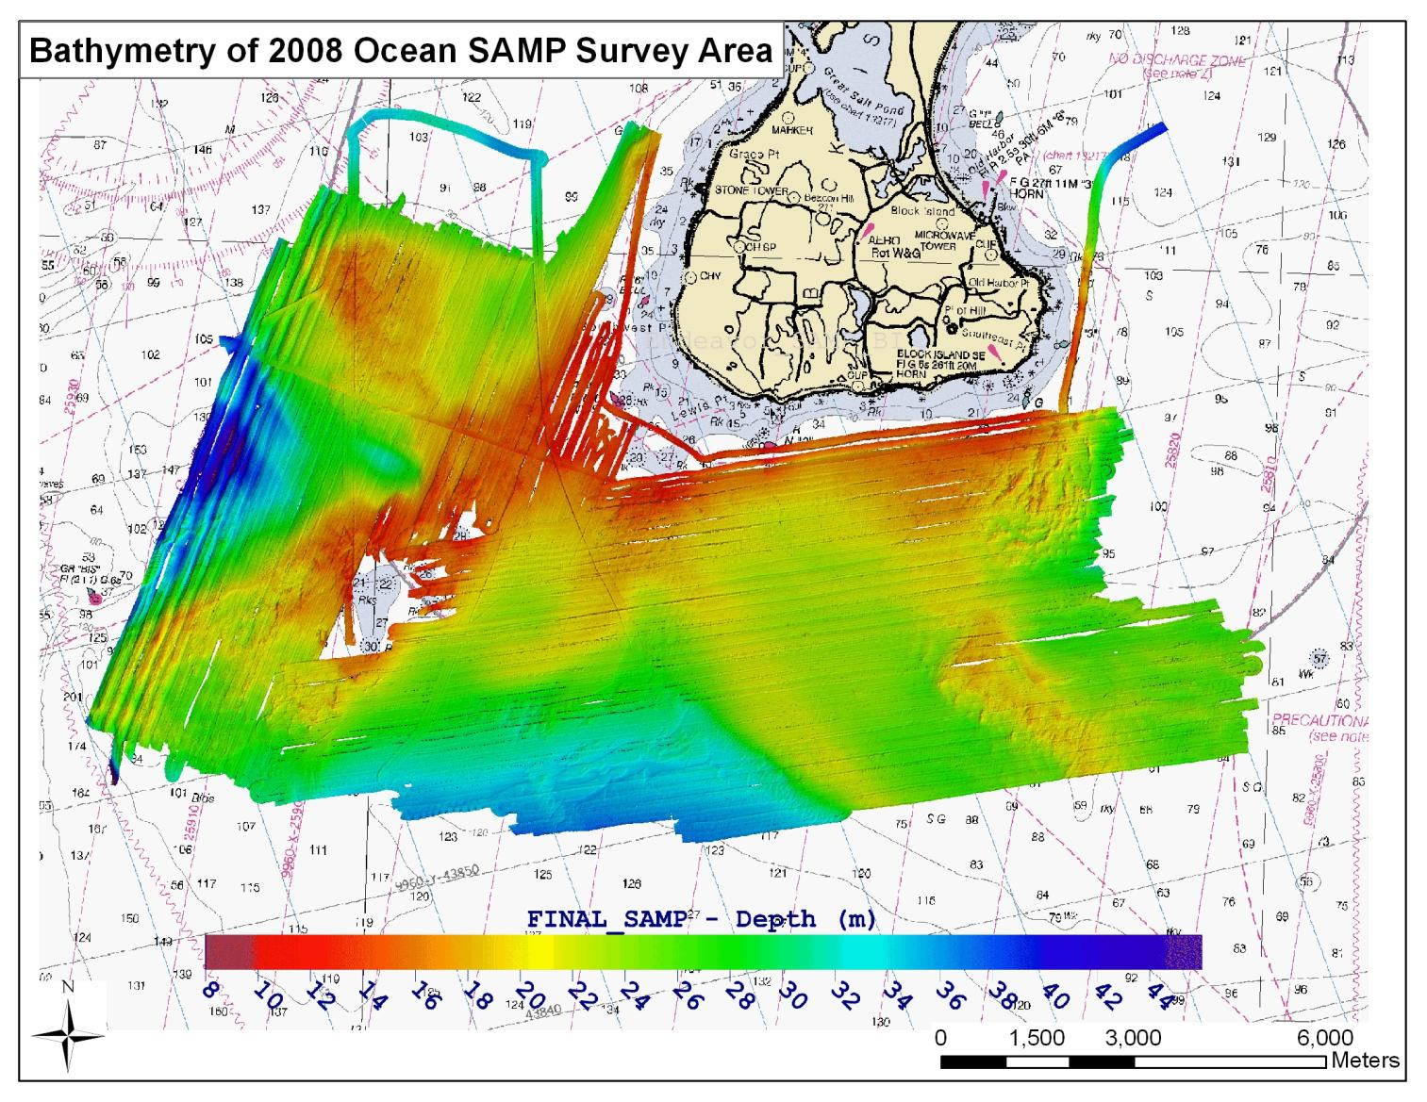
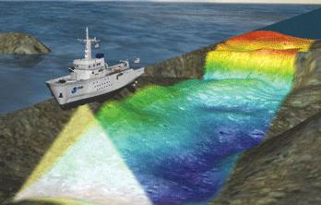
Notes:
Bathymetry of SAMP area from 2008 Endeavor Survey. The South West Ledge, the north eastern portion of the survey area, and other gaps have been filled in – that data is currently being processed. We have also collected data near the shoreline. This map is 2 meter resolution.

Slide 24
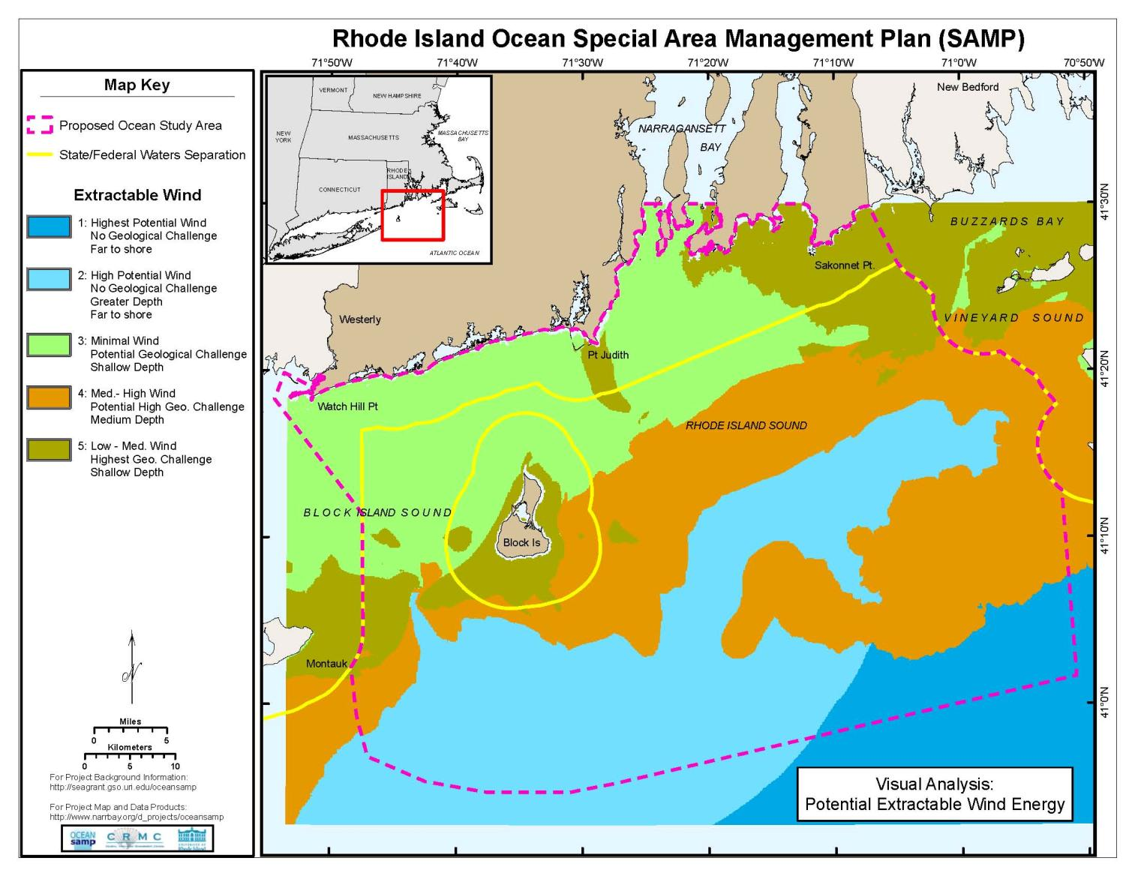

Slide 25
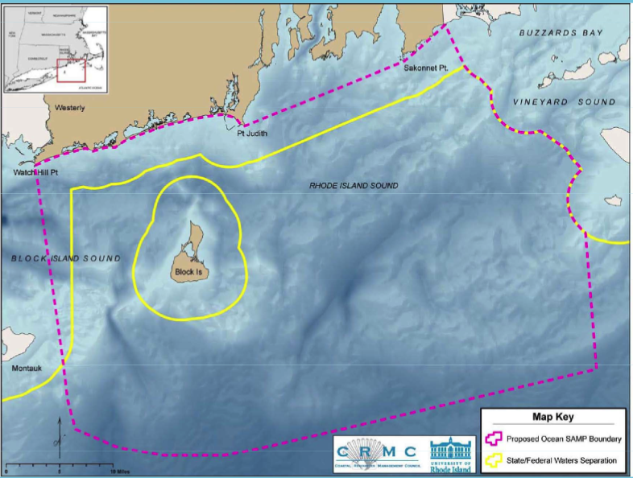
Research Focused Sites

Slide 26
Defining Features of the RI Approach
RI policy and legislative framework is “streamlined”
The State is leading this process
University provides trusted science and outreach
SAMP takes an ecosystem-based approach
Transparent process engages all stakeholders from the very beginning

Slide 27
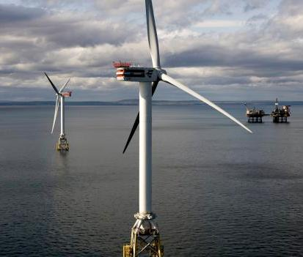
Current Renewable Proposals
Deepwater Wind (DWW) becomes State’s Preferred Developer for offshore wind power within the SAMP (Fall 2008).
DWW agrees to provide 15% of all electricity used in the entire state.
Notes:
State requirement that National Grid puschase some of its electricity from renewable energy sources.
An agreement between the utility and energy provider will be subject to approvle from the RI Public Utilities Commission.
Natoina Grid has until October 15th to present the commission with its prefered contract. The commission is schedule to make a decision by the end of the year.
Deepwater Wind hopes to secure a separate contract with National Grid to sell electricity from a larger wind farm with about 100 turbines proposed of 15 miles of fthe coasta.
Stat law mandating the process appears desgin in a way to favor a did from Deepwater.
Septebmer 25, 2008 the State announce that DWW had been selected as the preferred deverloper
DWW is the State’s “Preferred Developer” of offshore wind power within the SAMP
The Sate shall object in any appropirate state or federal forum to any offhosre wind power project or any electric powere transmission facility, that would interfere with the Project

Slide 28
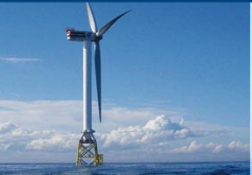
Terms
DWW shall:
Locate corporate manufacturing Headquarters in RI.
Enter into a Lease Option at Quonset Business Park.
Contract for the manufacturing or assembly of any required vessel(s).
Notes:
State requirement that National Grid puschase some of its electricity from renewable energy sources.
An agreement between the utility and energy provider will be subject to approvle from the RI Public Utilities Commission.
Natoina Grid has until October 15th to present the commission with its prefered contract. The commission is schedule to make a decision by the end of the year.
Deepwater Wind hopes to secure a separate contract with National Grid to sell electricity from a larger wind farm with about 100 turbines proposed of 15 miles of fthe coasta.
Stat law mandating the process appears desgin in a way to favor a did from Deepwater.
Septebmer 25, 2008 the State announce that DWW had been selected as the preferred deverloper
DWW is the State’s “Preferred Developer” of offshore wind power within the SAMP
The Sate shall object in any appropirate state or federal forum to any offhosre wind power project or any electric powere transmission facility, that would interfere with the Project

Slide 29
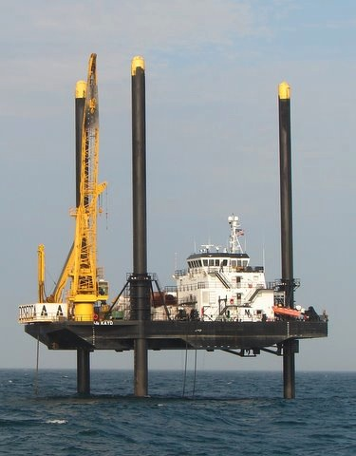
What’s happening now
MMS Rhode Island Task Force facilitates federal and state coordination.
DWW submits request for National Grid to buy electricity from wind farms.
Ocean SAMP begins Step 2 of process (e.g. zoning, policies).

Slide 30
Next Steps
National Grid bidding process “resolved” by the end of the year.
Ocean SAMP completes zoning and zoning process.
State permits requested AFTER SAMP is completed (August 2010) to begin development in 2012.
MMS begins Federal leasing process.

Slide 31
For further information
  Ocean SAMP:
  Jennifer McCann, Ocean SAMP, mccann@gso.uri.edu or 401.874.6127
  http://seagrant.gso.uri.edu/oceansamp/index.html
  CRMC Regulations:
  Laura Ricketson-Dwyer, CRMC public educator and information coordinator, lricketson@crmc.ri.gov or 401.783.7886

